Slide 1
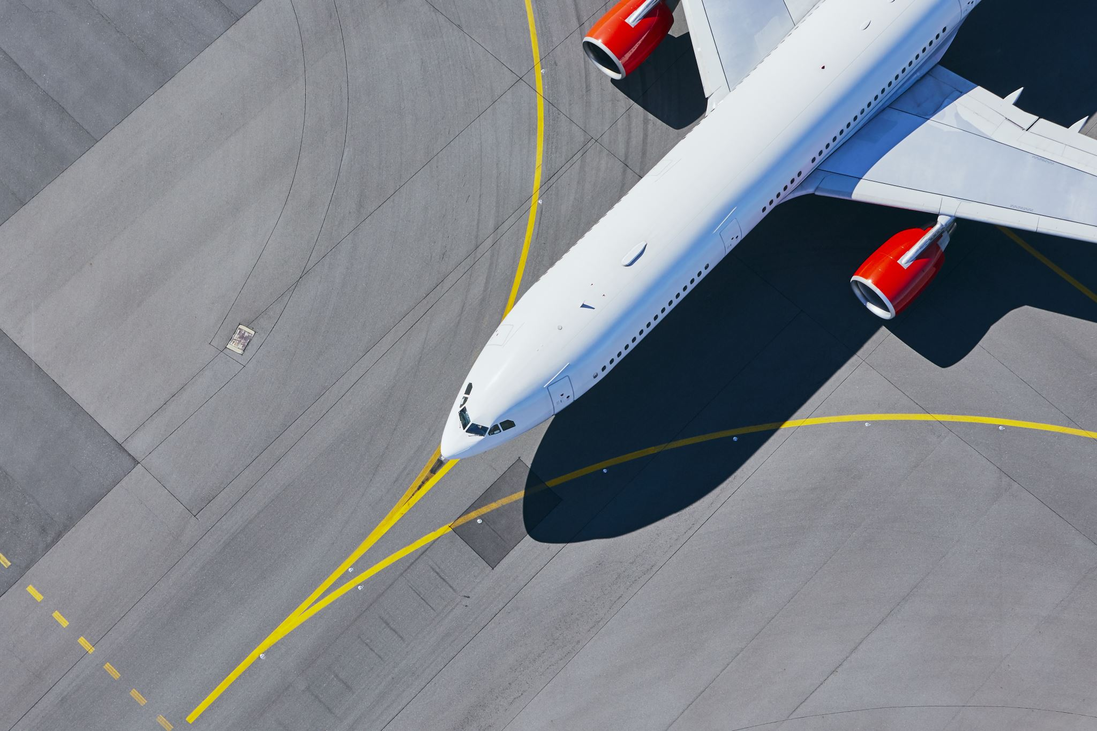

Predicting Taxi Out delay Airplane

Slide 2
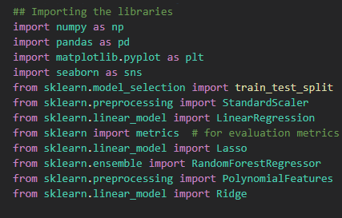
Importing Libraries
Notes:
I started importing the libraries. In the screenshot you can see many libraries because I made an attempt with every single regression method we’ve been taught, even though for this presentation I will show just the one with higher outcome.

Slide 3
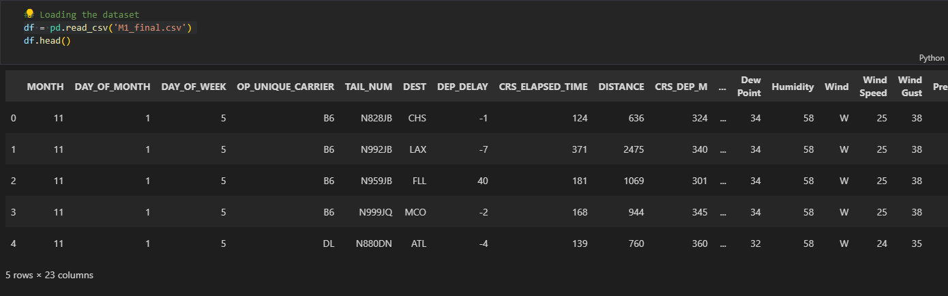
Loading the Dataset

Slide 4
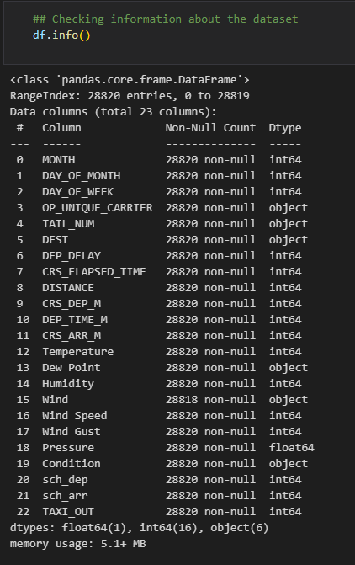
Checking out datatypes

Slide 5
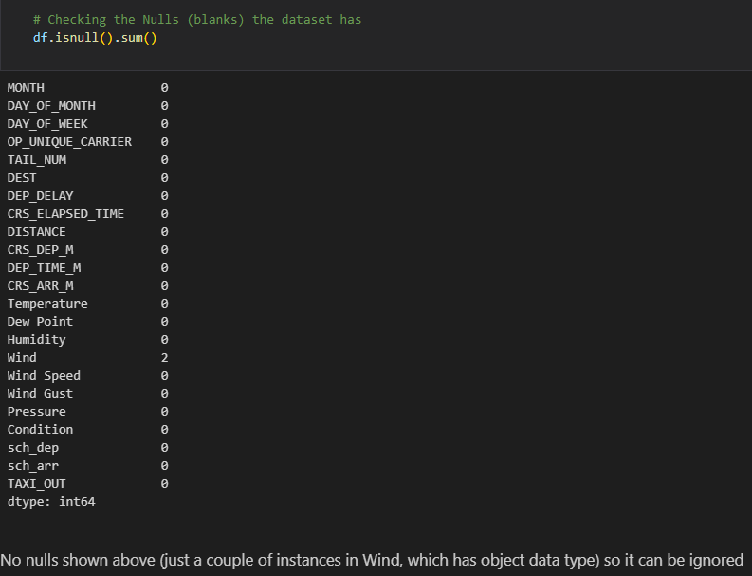
Checking Nulls

Slide 6
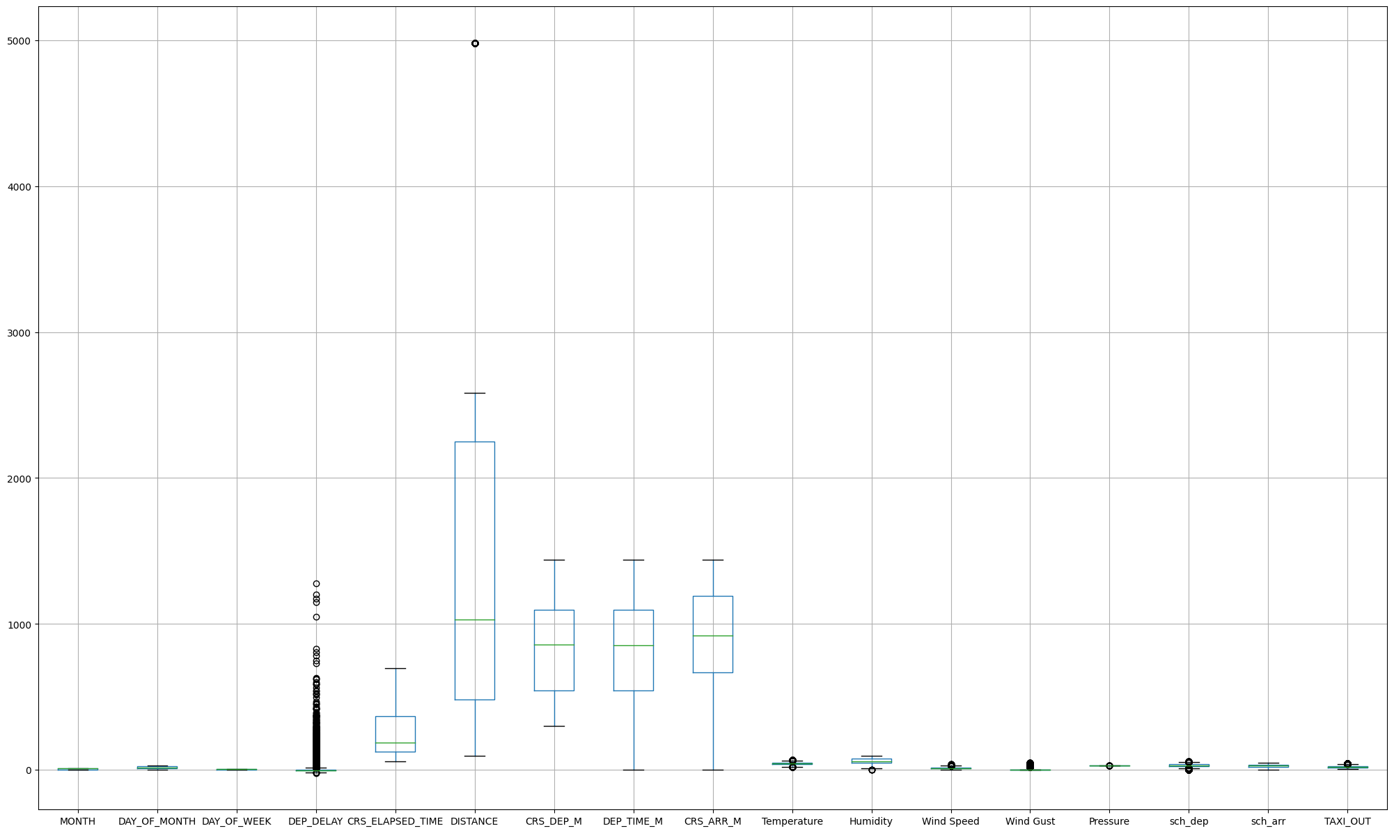
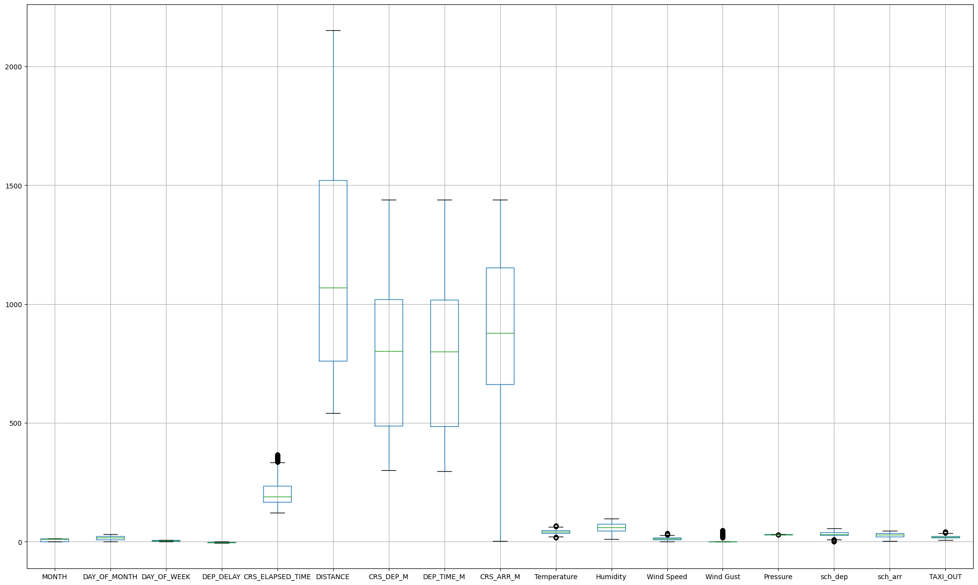
Box Plots
Notes:
Removing outliers: DEPARTURE_DELAY and DISTANCE columns

Slide 7
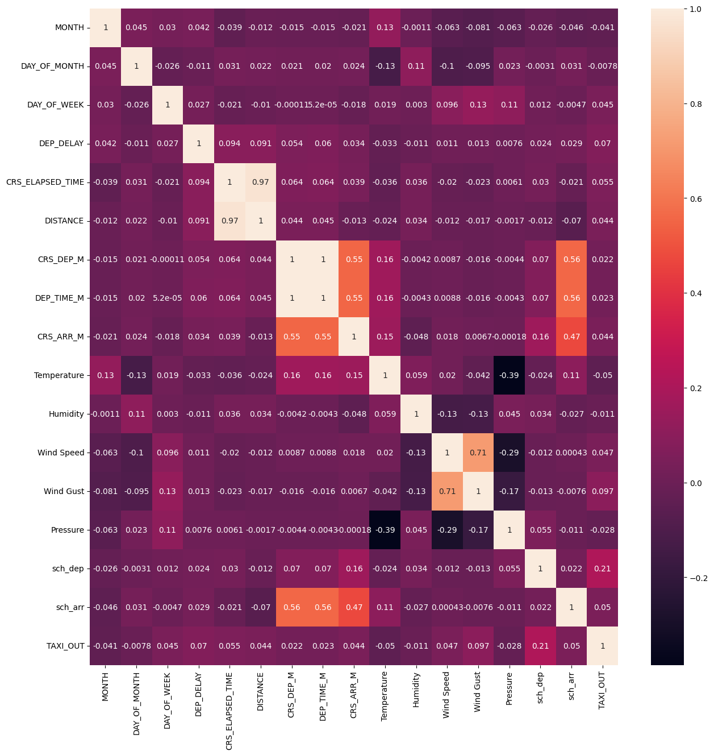
Heatmap
# - CRS_Elapsed_time (Scheduled journey time of the flight) and Distance have almost the strongest correlation possible (0.97)
# - CRS_Dep_M (Scheduled Departure Time) has perfect (1) correlation with Dep_Time_M (Actual Departure Time). Also CRS_Dep_M has moderate correlation (0.55) with CRS_ARR_M
# - Dep_Time_M moderate correlation with CRS_ARR_M (0.55)
# - CRS_Dep_M moderate with sch_arr (0.56)
# - Dep_Time_M moderate with sch_arr (0.56)
# - Wind Speed and Wind Gust features are about moderate to strong correlated (0.71)

Slide 8
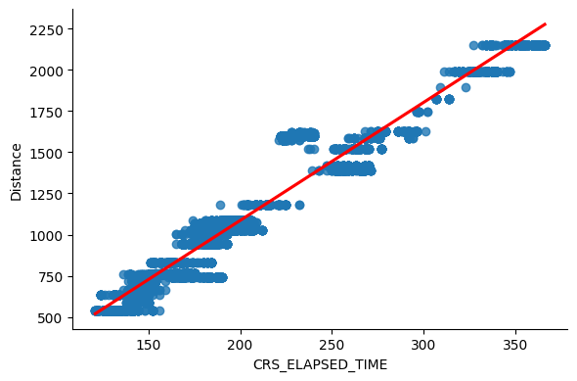
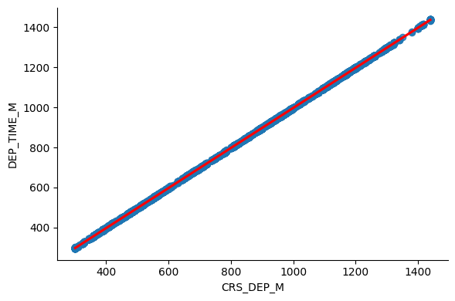
Scatter Plots

Slide 9


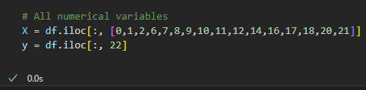
ML Pre-processing
3 scenarios

Slide 10
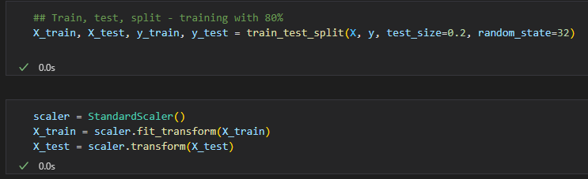
ML Pre-processing

Slide 11
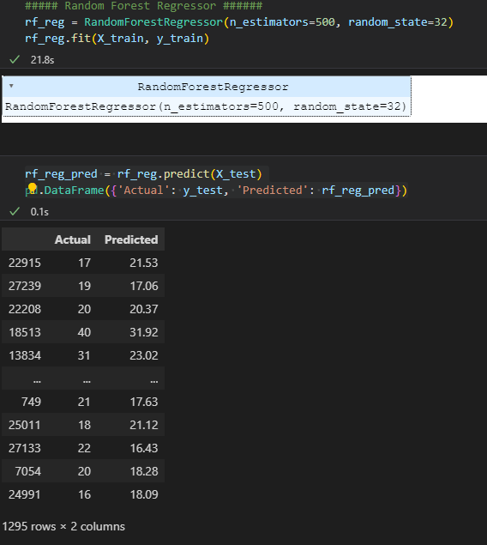
ML Model

Slide 12
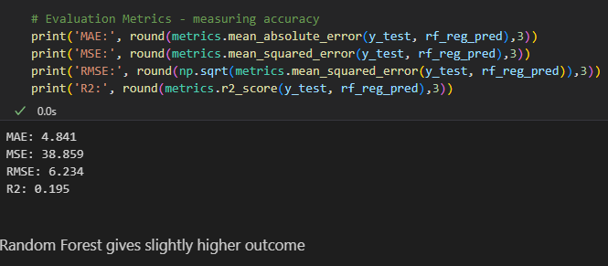
Evaluation Metrics

Slide 13


Thank you

